Slide 1

Detecting Deep Fake Faces
By: Rahul torlapati
Data 606
https://github.com/rahultorlapati/DATA606

Slide 2
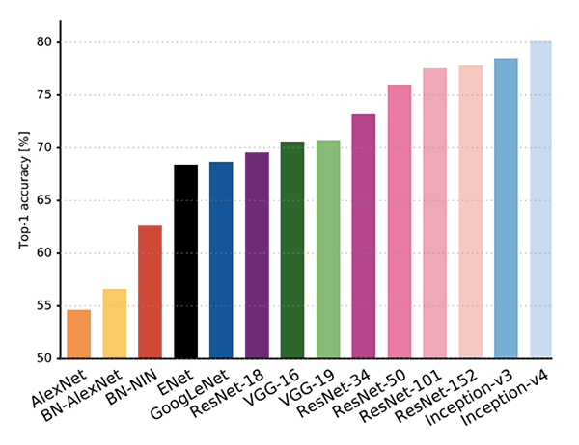
GoogleNet
GoogLeNet (Inception v1) is a pretrained convolutional neural network that is 22 layers deep is one of such approaches.
Although GoogLeNet has 22 layers it consists of 12x less parameters

Slide 3
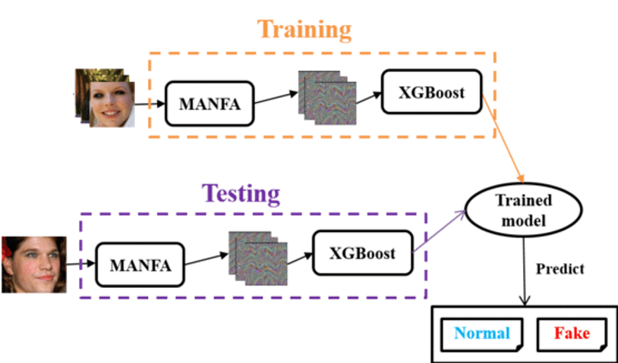
MANFA
MANFA which is a hybrid framework which that uses Adaptive Boosting (Adaboost) and eXtreme Gradient Boost (XGBoost).

Slide 4
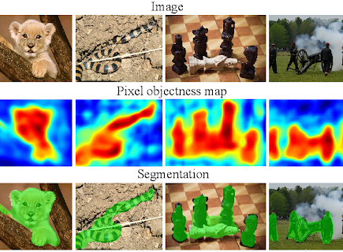
Pixel-level analysis
Pixel-level analysis is another such approach which tackles the problem of failing to capture high quality features, which generally lead to sub-optimal solutions.
Pixel-level analysis is a pixel-level segmentation task which evaluates multiple architectures on both segmentation and classification tasks.

Slide 5
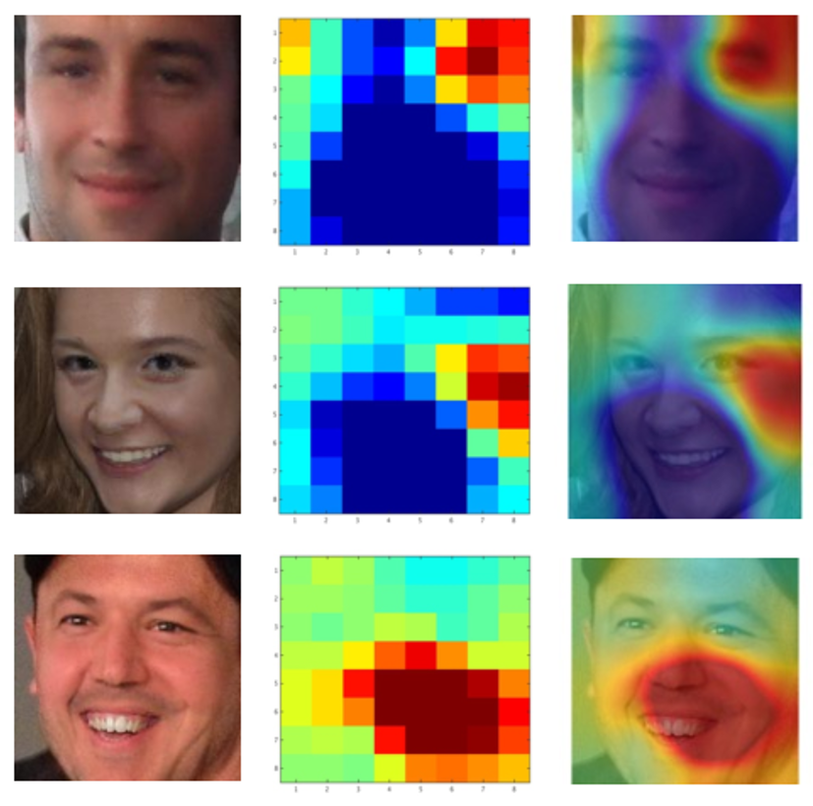
Two-Stream Neural Network
Train GoogLeNet to detect tampering artifacts in a face classification stream
Train a patch-based triplet network to leverage features capturing local noise residuals and camera characteristics as a second stream.

Slide 6
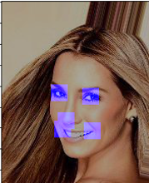
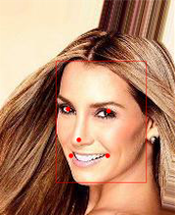
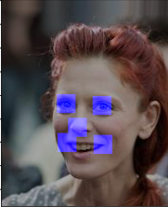
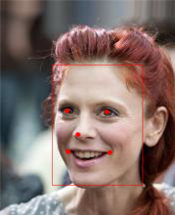
PRELIMINARY WORK
CNN (Convolutional Neural Network) to detect eyes, nose, mouth and facial areas in a person’s face.
The dataset folder has an additional file list_landmarks_align_celeba221.csv which contains information as to the location of eyes, nose, mouth and facial areas in an image.
I’ve compared the output generated by the CNN to the landmarks file and the results are similar.

Slide 7
Goal PEER REVIEW CLARIFICATION
Dataset is a combination of 200k real faces, 200k GAN-generated faces and is split into training and test sets.
Train a Neural Network on the training set to learn facial features, gender, age and other attributes.
Test Neural Network on the test set and determine whether the image is real face or GAN-generated.
Distribution of the dataset
Features used for detecting Age and Gender
Measure of Success

Slide 8
Next Deliverable
Isolate Facial Areas in Image and Compare them.
Determining gender from facial features

